Slide 1

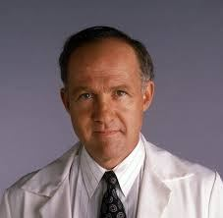
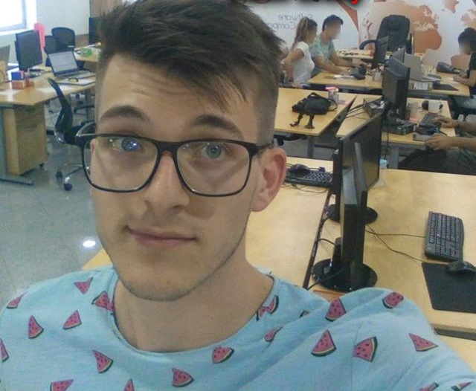
Software Engineering
A Practitioner’s Approach
The Book by: Roger S. Pressman
I made those slides retyping highlights of the most important parts.
I wrote it as I would retell it to anyone.
Slides by: Zack Enixey

Slide 2

Part 1 - Chapter 1
Software And Software Engineering

Slide 3
The goal is to make a software that succeeds, that meets the needs of the people who use it, that performs flawlessly over a long period of time, that is easy to modify and even easier to use. This kid of software can and does change things for the better
Use this book as a framework! Pick techniques from here you like, and study them thoroughly.

Slide 4
The book contains of 5 capital parts:
The Process, presents a variety of different views of software process,
Modeling, presents analysis and design methods
Quality Management, presents the concepts, procedures, techniques
Managing Software Projects
Advanced Topics, considers software process improvement and software engineering trends

Slide 5
What is a “software”?
A computer software is THE PRODUCTS that software professionals build. It encompasses programs that execute within a computer.
Software engineers build and support software.
We develop software and at the same time we’re developing it on another software. “Software is both a product and a vehicle that delivers a product”.
Software delivers the most important product of our time: “information”.
Software is logical rather than a physical.
Software is developed or engineered, while hardware is manufactured.
Software doesn’t wear out, but hardware does wear out.

Slide 6
Software engineering
Software engineering is the application of engineering to the development of software in a systematic method.
A concerted effort should be made to understand the problem before a software solution is developed, therefore DESIGN becomes a pivotal activity.
Software should always exhibit high quality.
Software engineering encompasses a process, methods for managing and engineering software and tools
Software engineering: “the application of a systematic, disciplined, quantifiable approach to the development, and maintenance of software.

Slide 7
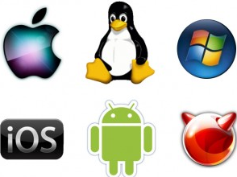
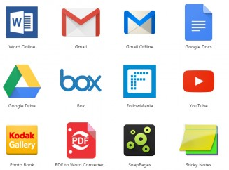

7 categories of computer software
System software: a collection of programs written to service other programs Operating systems or utility software: (e.g. Windows, Ubuntu, compilers, editors…), characterized by multi-threading
Application software: stand alone programs, I see them as any App you can download from the Google Store.
Engineering/scientific software: characterized by number crunching algorithms. They are real time apps. (e.g. Matlab, CATIA…)

Slide 8
7 categories of computer software
Embedded software: software that’s embedded a certain product (cars, telephones, robots, toys...)
Product-line software: provides a specific capability for use by many different customers.
Web applications: user-server communication software
Artificial intelligence software: makes use of non-numerical algorithms to solve complex problems that are not amenable to computation or straight forward analysis.

Slide 9
Web Apps are the most common software today, and they are characterized by:
Network intensiveness, Concurrency, more people are using the app at the same time, and the number of user vary from day to day so there’s unpredictable load. Performance must be good, and availability has to be almost 24/7. Web Apps are data driven, we use web app to access databases on the other side. Web Apps are content sensitive, aesthetics is important. They also evolve continuously, and web app need to hit the market as quickly as possible. Web Apps need to provide security,

Slide 10
The software process
A process is a collection of activities, actions, and tasks that are performed when some work product is to be created.
An activity strives to achieve a broad objective (e.g. communication with stakeholders),
An action (e.g. architectural design) encompasses a set of tasks,
A task focuses on a small, but well-defined objective (e.g. conducting a unit test)
A process defines who is doing what when and how to reach a certain goal.

Slide 11
Process framework
Process framework encompasses 5 activities:
Communication
Planning
Modeling
Construction
Deployment
The essence of software engineering practice:
Understand the problem (communication and analysis)
Plan a solution (modeling and software design)
Carry out the plan (code generation)
Examine the result for accuracy (testing and quality assurance)

Slide 12
Umbrella activities
Umbrella activities help a software team to manage and control progress, quality, change, and risk. Their intent is to improve system quality, make projects more manageable, make delivery dates and costs more predictable, and guide teams of software engineers. Umbrella activities include:
Software project tracking and control
Risk management, assessing risks that may affect the outcome of the project
Software quality assurance
Technical reviews
Measurement
Software configuration management
Reusability management
Work product preparation and production

Slide 13

David Hooker’s 7 principles that focus on software engineering practice:
This dude works for Cisco
Always check will the software be able to sell on the market, does it have any value.
KISS – keep it strictly simple
Maintain the clear vision
Always implement like it will be used by some psycho who knows where you live.
Be open to the future, because changes are to happen.
Make it reusable.
Think. Complete you thought before you proceed to the action. Understand the idea before you start

Slide 14
Part 1 - Chapter 2
Process Models

Slide 15
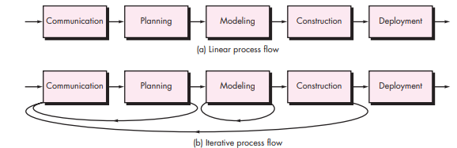
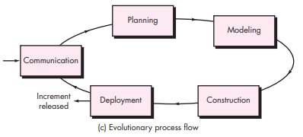
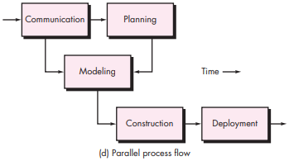

Slide 16
Process framework activity No.1: COMMUNICATION
The communication activity has 6 distinct actions:
Inception (start, beginning)
elicitation (more commonly called “requirements gathering”)
elaboration
Negotiation
Specification
validation

Slide 17
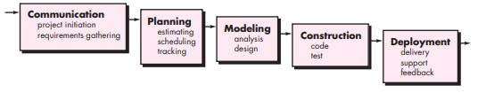
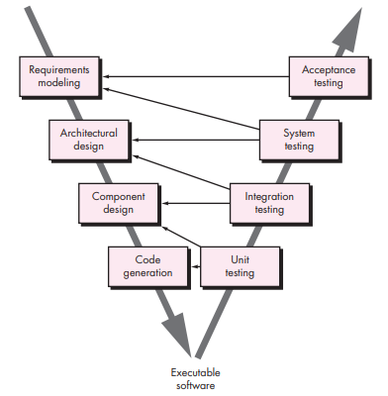
‘Waterfall’ and ‘V’ model
The waterfall model, sometimes called the classic life cycle, suggests a systematic, sequential approach. The problem is that to go on the next section, previous one has to be completely finished. No going back. Customer has to state all requirements at the start at once. A working version of the program will not be available until late in the project time span. Real projects rarely follow the sequential flow.
A variation in the representation of the waterfall model is called the V-model. As the software team moves down the left side of the V, basic problem requirements are refined into detailed and technical representations of the problem and its solution. Once code is generated, the team moves up the right side of the V, performing a series of tests.

Slide 18
Incremental and Evolutionary model
Evolutionary process models produce an increasingly more complete version of the software with each iteration.
Evolutionary models are iterative.
There’s two types of evolutionary models:
Prototyping (not so interesting) 1. build a prototype, 2. get more info from a customer, 3. throw the mode, 4. make a new app. The problem is that customer thinks that first prototype is final product, do not extend a rough prototype into a production product. “Put Quality over everything”
The Spiral Model (the best one)
The incremental model delivers a series of releases, called increments, that provide progressively more functionality for the customer as each increment is delivered.
We provide set of software functionality to user QUICKLY.
This way we gain feedback on every release.

Slide 19
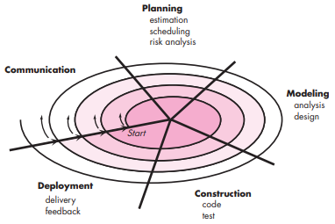
Spiral model
Using Spiral model, software is developed in a series of evolutionary releases.
This way we’re progressively making more sophisticated version of the software on every new iteration.
The first circuit around the spiral might represent a “concept development project”
The spiral model is realistic approach to the development of large scale systems and software.
We learn from customer’s feedback
This way on every iteration we regenerate the plan and we reflect the reality.
If the evolutions occur too fast, without a period of relaxation, it’s certain that the process will fall into chaos.

Slide 20
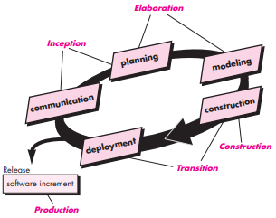
Unified Process UP and Personal Software process PSP
The only new phase at UP is the transition phase: ‘Software is given to end users for beta testing and user feedback reports’.
PSP has 5 framework activities:
Planning: this isolates requirements and gives us estimations.
High-level design: external specifications for each component to be constructed are developed and decide deep design is created.
High-level design review: uncovers errors in design
Development: code is generated, review, compiled.
Postmortem: the effectiveness of the process is determined
PSP stresses the need to identify errors early. Don’t waste time studying this, PSP requires lot’s of training, that’s why it’s not widely adopted.

Slide 21
Part 1 - Chapter 3
Agile Development

Slide 22
Agility
The goal of agility is to reduce the costs of change. We will have changes in the future, and we want them to be as cheep as possible.
Change is what software development is very much about.
Agility doesn’t mean hacking out solutions
Agility adopts customer as a part of the development team. (customer feedback <3)
Based on incremental delivery strategy that gets working software to the customer as rapidly as possible.
The cost of change is reduced because software is released in increments and change can be better controlled within an increment.
Design and construction are interleaved (both activities should be performed in tandem)
Working software is ok, but it must exhibit also: reliability, usability, maintainability

Slide 23
12 Agility principles
Our priority is to satisfy the customer
Welcome changing requirements
Deliver working software frequently
Business people and developers must work together daily
Build projects around motivated individuals
Face-to-face conversation
Working software is the primary measure of progress
Sponsors, developers and users should maintain a constant pace
Continuous good design
KISS, simplicity
Best architecture emerge from self-organizing teams
The team reflects on how to become more effective

Slide 24
A number of key traits must exist among the people on an agile team:
Competence: (innate talents, software skills).
Common focus: all should be focused on one goal ‘to deliver working software’.
Collaboration: using, creating or building information that provides business value for the customer. Using creation to multiply talent and creativity.
Decision-making ability: the team is given autonomy
Fuzzy problem-solving ability
Mutual trust and respect
Self-organization: the team makes its own commitments and defines plans to achieve them. “Do not put pressure on me, I will put pressure on me”
In team we must: Criticize without animosity, assist without resentment, work as hard as we can, have the skill set to contribute, communicate problems or concerns in a way that leads to effective action.

Slide 25

Extreme programming XP
KISS
The most widely used approach to agile software development
XP Values: set of 5 values that establish a foundation for all work performed as part of XP: communication, simplicity, feedback, courage, and respect.
XP uses an Object-Oriented approach.
Key XP activities: ( Planning, Design, Coding, Testing)
Planning: the planning activity begins with listening (requirements gathering) it helps us understand the business context for the software.
User is required to write User Stories. User stories describe required output features and functionality for software to be built. Each story is written by a customer and is placed on an index card. The customer assign value (priority) to the User Story. (If the Story is estimated to be developed for more than 3 weeks, that user need to split that one user story into more smaller user stories). The stories with highest value will be moved up in the schedule and implemented first.
Project velocity: the number of customer stories implemented during the first release.

Slide 26
Extreme programming XP
Design: this is next XP key activity. XP design rigorously follows KISS. The XP design provides implementation guidance for a story as it is written, nothing more than guidance. If a difficult design problem is encountered as part of the design of a story, XP recommends immediate creation of an operational prototype of that portion of the design: “if design is too complicated just create any operational prototype. This is called Spike solution. Design occurs both before and after coding. A key concept introduced with XP is PAIR PROGRAMMING (two heads are often better than one)
Refactoring: the process of changing a software system in such a way that it does not alter the external behavior of the code yet improves the internal structure.
Testing: Fixing small problems every few hours takes less time than fixing huge problems just before the dead line.

Slide 27
Industrial Extreme Programming IXP
Used within large corporations. It’s XP + some new practices:
Readiness assessment: does an appropriate development environment exists to support IXP, do we have proper set of stakeholders etc.
Project community: people on the team must be well-trained, adaptable and skilled.
Project chartering: to determine whether an appropriate business justification for the project exists.
Test driven management: an IXP projects requires measurable criteria for assessing the state of the project and the progress that has been made to date.
Retrospectives: the review examines “issues, events, and lessons-learned”
Continuous learning: it’s a MUST! Learn, learn, learn
The problems with XP are: changes to requirements are requested informally, conflicting customer needs, the moment when you implement their last wish, and they say “I didn't mean it like that”, Lack of formal design, everything is spontaneous, it downplays analysis and design…

Slide 28
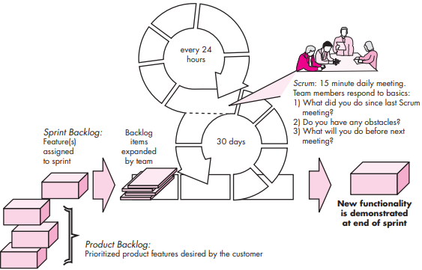
SCRUM
Scrum incorporates framework activities: requirements, analysis, design, evolution, and delivery
Within each mentioned framework activity, work tasks occur within a process pattern called a sprint.
Sprint: consists of work units that are required to achieve a requirement defined in the backlog that must be fit into a predefined time-box (typically 30 days)
Sprint allows team to work in a short-term.

Slide 29
Dynamic Systems Development Method (DSDM)
DSDM is for practical people
Pareto principle – 80% of an application can be delivered in 20% of the time needed to develop whole application. DSDM is for practical people.
Feature Driven Development (FDD) is for large projects
In FDD we decompose big problems into small features
Features are small blocks of deliverable functionality, so their design and code are easier to inspect and implement.
Lean Software Development (LSD) – get rid of unnecessary stuff
Agile Modeling (AM) – introducing UML, and principles like: Model with purpose, Use multiple modes, Use models as travel light…

Slide 30
The End Of Part 1
The Software Process

